Slide 1
Solving Cyclic Longest Common Subsequence in Quadratic Time
Andy Nguyen , arxiv, 2012.
Presenter: ZHI-CHENG SHEN
Date: Feb.07 , 2023

Slide 2
Abstract
We present a practical algorithm for the cyclic longest common subsequence (CLCS) problem that runs in O(mn) time, where m and n are the lengths of the two input strings. While this is not necessarily an asymptotic improvement over the existing record, it is far simpler to understand and to implement.

Slide 3
Cyclic Longest Common Subsequence(CLCS)
1. Given a string A of length n and an integer k, 0 ≤ k < n, we can define cut(A, k) = substring(A, k,n)+substring(A,0, k).
Ex. cut(“abcd”,2) = “cd” +“ab” = “cdab”
cut(“abcd”,0) = “abcd” +“ ” = “abcd”.
2. CLCS(A,B) = LCS(cut(A, k),B) for some integer k.
3. Time complexity = O(m²n), strlen(A) = m, strlen(B) = n.

Slide 4
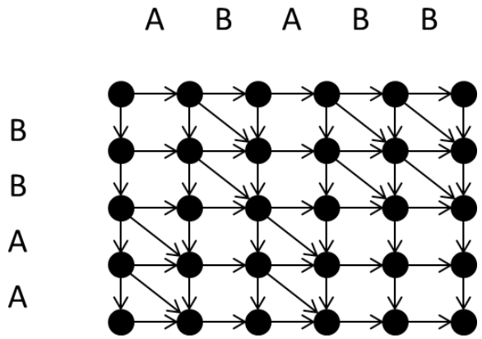
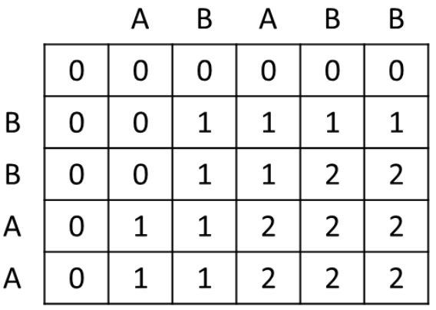
Longest Common Subsequence(LCS)

Slide 5
1. The graph G_{A,B} is acyclic.
2. Lemma . Finding an LCS(A,B) is equivalent to finding a shortest path from (0,0) to (m,n) in G_{A,B}.
3. Corollary . The set of parent pointers computed by any DP solution to LCS(A,B) (when treated as undirected edges) forms a shortest path tree of G_{A,B} rooted at (0,0).
4. We can solve LCS by solving a shortest path problem on a directed acyclic graph with unit edge lengths.

Slide 6
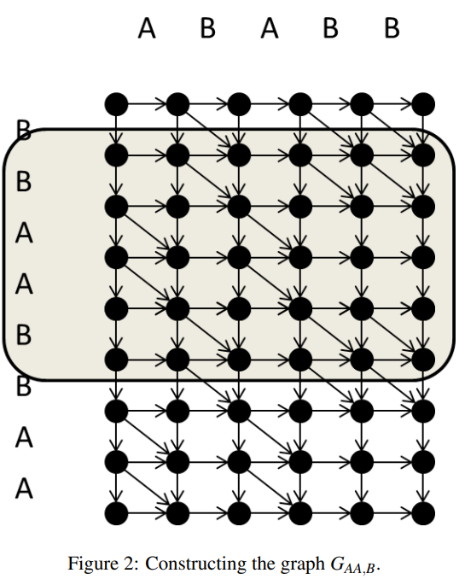
We can solve CLCS by solving m shortest-path problems, one for each cut of A.
we can reuse some work between shortest path computations.

Slide 7
Lowest Shortest Path Tree
Definition . A lowest shortest path tree of G_{A,B} is a shortest path tree where for every node v, the path from the root to v contained in the shortest path tree is lower than any other shortest path from the root to the node.
1. How to compute lowest shortest path tree?
2. The set of parent pointers computed by the DP solution that favors ← first, then ↖, and finally ↑ in case of ties forms a lowest shortest path tree of G_{A,B} rooted at (0,0).

Slide 8
 |  | a | b | a | b | b
 | 0 ↑ | 0 ← | 0 ← | 0 ← | 0 ← | 0 ←
b | 0 ↑ | 0 ← | 1 ↖ | 1 ← | 1 ← | 1 ←
b | 0 ↑ | 0 ← | 1 ↖ | 1 ← | 2 ↖ | 2 ←
a | 0 ↑ | 1 ↖ | 1 ← | 2 ↖ | 2 ← | 2 ←
a | 0 ↑ | 1 ↖ | 1 ← | 2 ↖ | 2 ← | 2 ←

Slide 9
If we compute the lowest shortest path tree of G_{AA,B}, we can immediately read off the shortest path from (0,0) to (m,n).
Before we can read the shortest path from (1,0) to (m+1,n), we need to re-root the lowest shortest path tree at (1,0). 這一步是降低時間複雜度的關鍵
This is equivalent to removing the top row entirely, and then fixing the remainder of the tree to restore its properties.
Lemma . If we remove the top row of nodes from the lowest shortest path tree rooted at (0,0), we are left with at most two subtrees L and (possibly) R.(root 在 level 0)

Slide 10
1. Lemma . For any entry (i, j) in the table, 0 ≤ len(i, j)−len(i, j −1) ≤ 1.
2. Corollary . Let (i, j) be such that (i, j) ∈ R but (i, j −1) ∈ L. Then len(i, j) = len(i, j −1) +1.
3. If we were to reconnect the two subtrees by setting parent(1, k +1) = ←, we would lower the length values of all nodes in R by exactly 1 (since we lose the diagonal of parent(1, k +1)).
4. Every boundary node (i, j) ∈ R satisfies len(i, j) = len(i, j − 1), which means in a lowest shortest path tree, parent(i, j) =←.

Slide 11
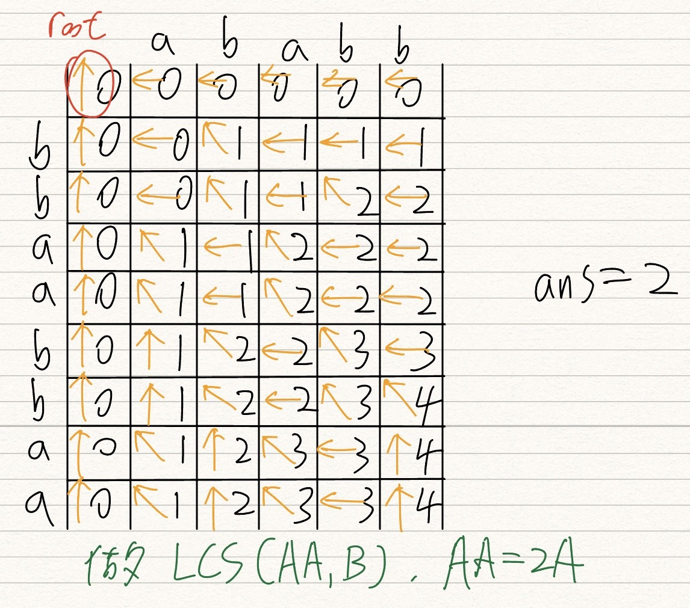
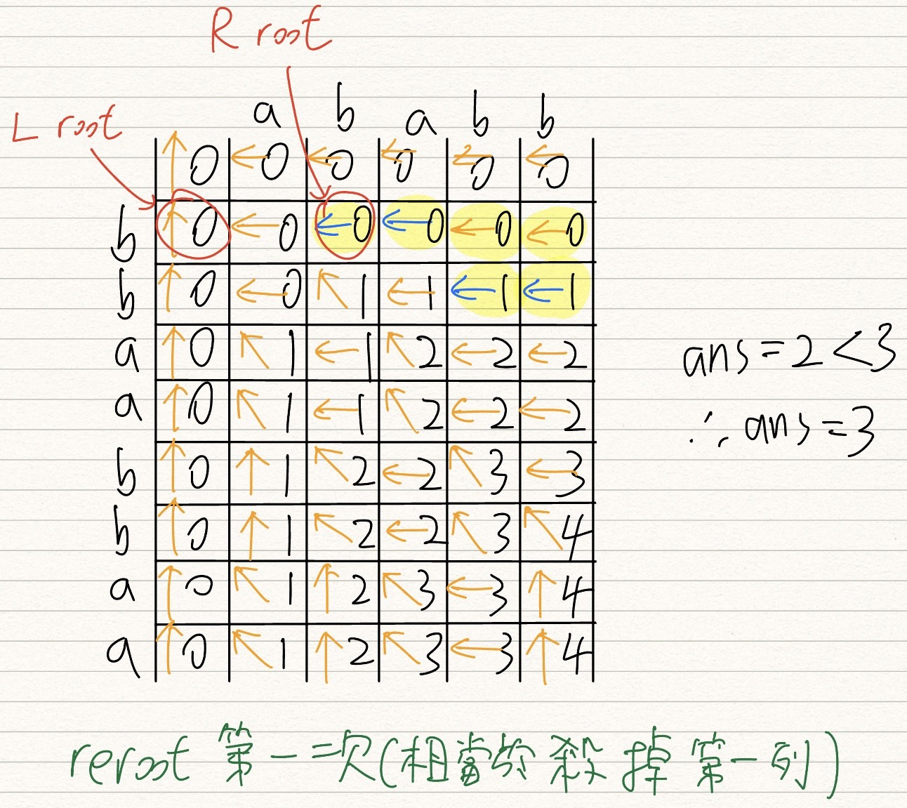

Slide 12
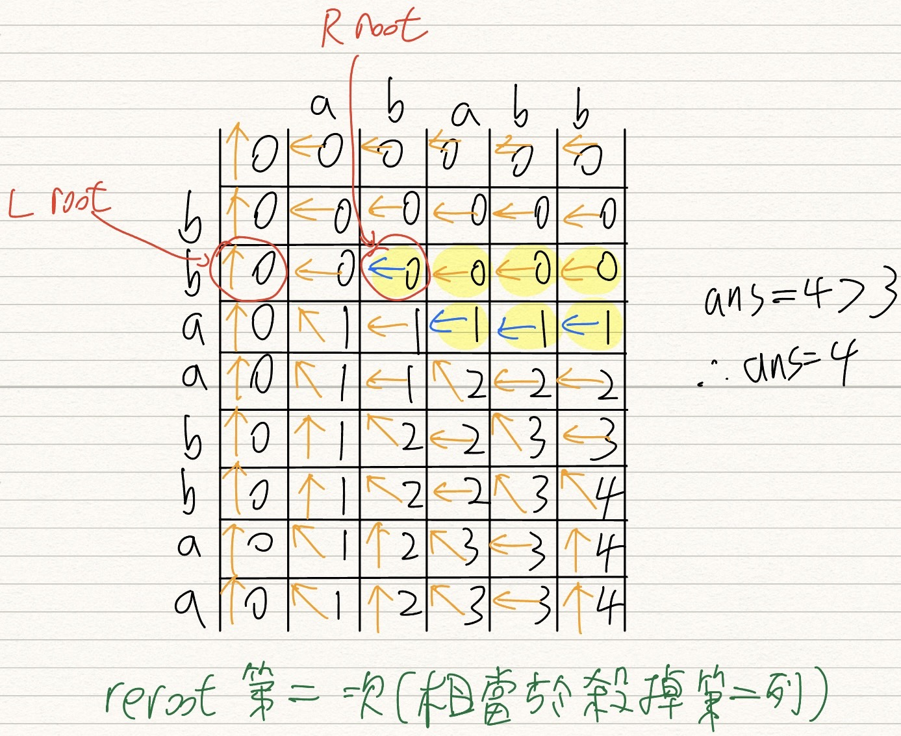
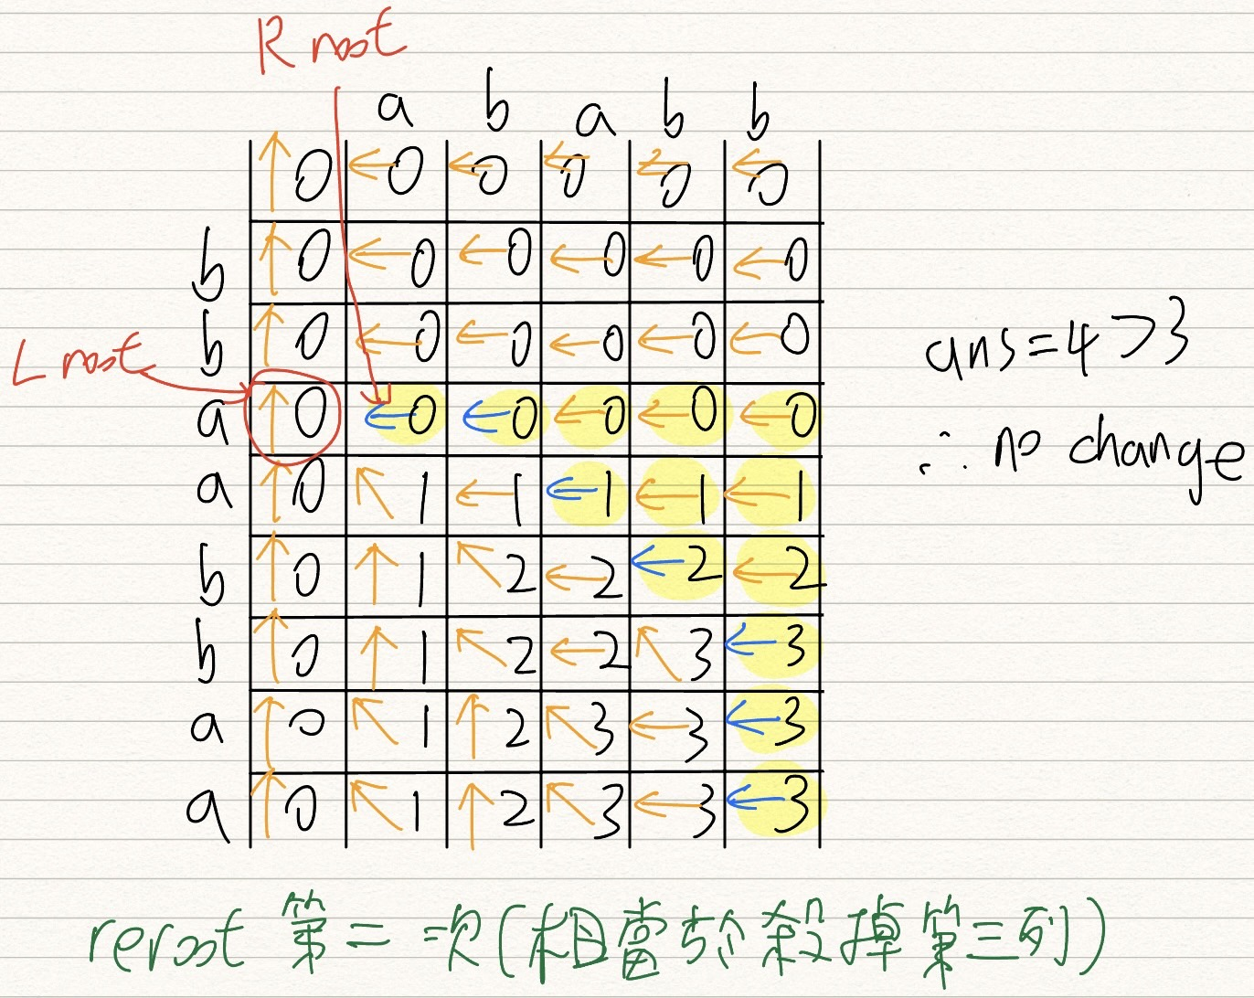

Slide 13
Note that we can walk along the graph to find all boundary nodes by moving down or right (or both), which means we can perform this rerooting process in O(m + n) = O(n) time.
We only need to do so m times, which means the entire process runs in O(mn) time.

Slide 14
Conclusions
We have presented a practical algorithm that solves CLCS in O(mn) time. Note that the proof of correctness relies heavily on the fact that all edges in the graph have weight 1. This means that this algorithm does not naturally apply to the usual extensions of the problem, such as edit distance and dynamic time warping. It may be worth investigating whether the algorithm can be adapted to certain classes of edge weights.

Slide 15
Thanks~

